Slide 1
Classification with PySpark

Slide 2
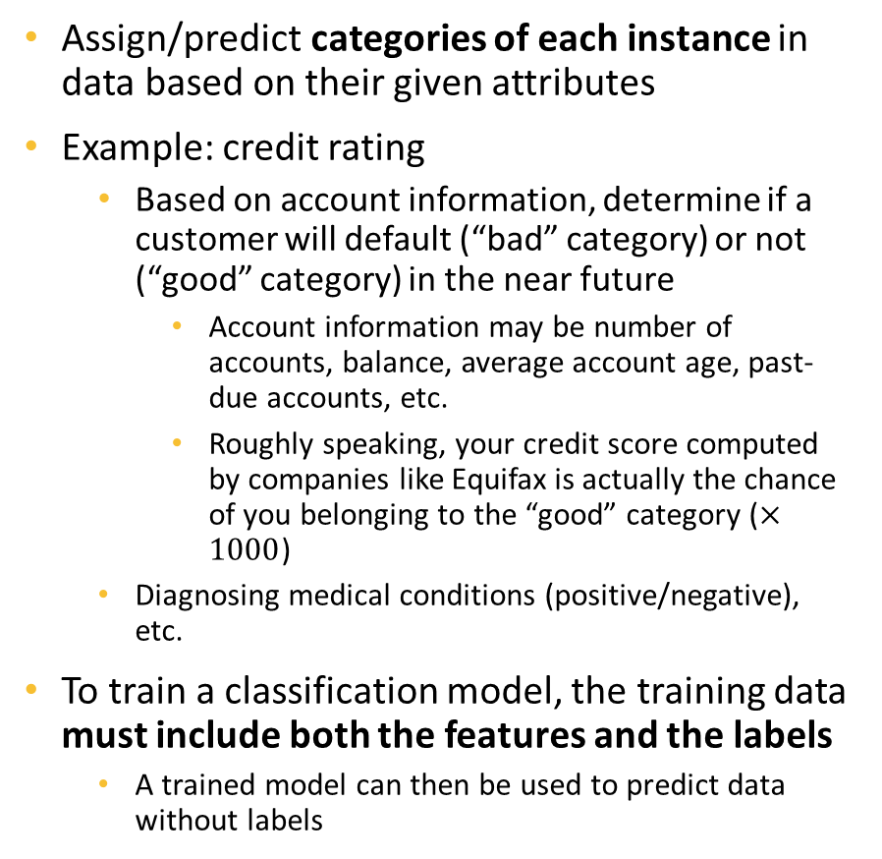
Classification
Enc_SSN | NoOfAcc | Balance | 3MnPstDue | 6MnPstDue
Ad9asgvjabl | 3 | 100 | 0 | 0
CLvb0das9b | 1 | 2500 | 1000 | 500
MCdfasd924 | 4 | 50 | 0 | 0
Mx9ta9fgak4 | 2 | 1200 | 200 | 0
Ro04ik2lv90 | 4 | 200 | 50 | 0
Class
Good
Bad
Good
Good
Good
Assign/predict categories of each instance in data based on their given attributes
Example: credit rating
Based on account information, determine if a customer will default (“bad” category) or not (“good” category) in the near future
Account information may be number of accounts, balance, average account age, past-due accounts, etc.
Roughly speaking, your credit score computed by companies like Equifax is actually the chance of you belonging to the “good” category ($×1000$)
Diagnosing medical conditions (positive/negative), etc.
To train a classification model, the training data must include both the features and the labels
A trained model can then be used to predict data without labels
Must provide both to train models
Enc_SSN | NoOfAcc | Balance | 3MnPstDue | 6MnPstDue
Ad9asgvjabl | 4 | 150 | 0 | 0
CLvb0das9b | 1 | 5000 | 3000 | 1000
Predict
Good
Bad
Only needs feature data to make predictions

Slide 3
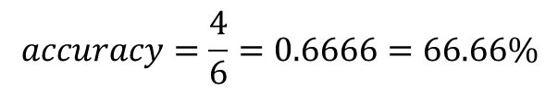
Evaluate a Classification Model - Accuracy
Accuracy is a common measurement used to evaluate classification models
Represents the rate of data which are predicted correctly
True class
Good
Bad
Bad
Good
Good
Good
Prediction
Good
Bad
Good
Bad
Good
Good
$$accuracy=\frac{4}{6}=0.6666=66.66\%$$

Slide 4
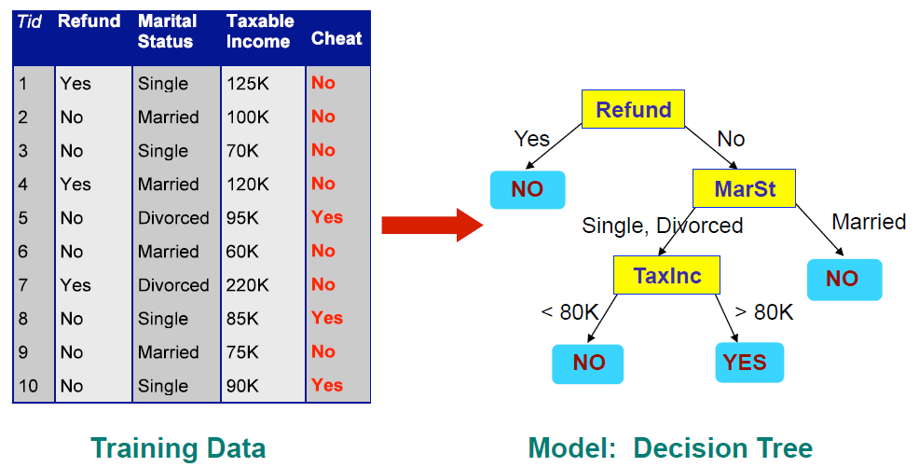
Decision Tree
Has a flowchart/tree-like representation
Each node represents a test on columns of data
Each branch represents an outcome of the node’s test
Terminal/leaf nodes decide the predicted labels of the instances

Slide 5
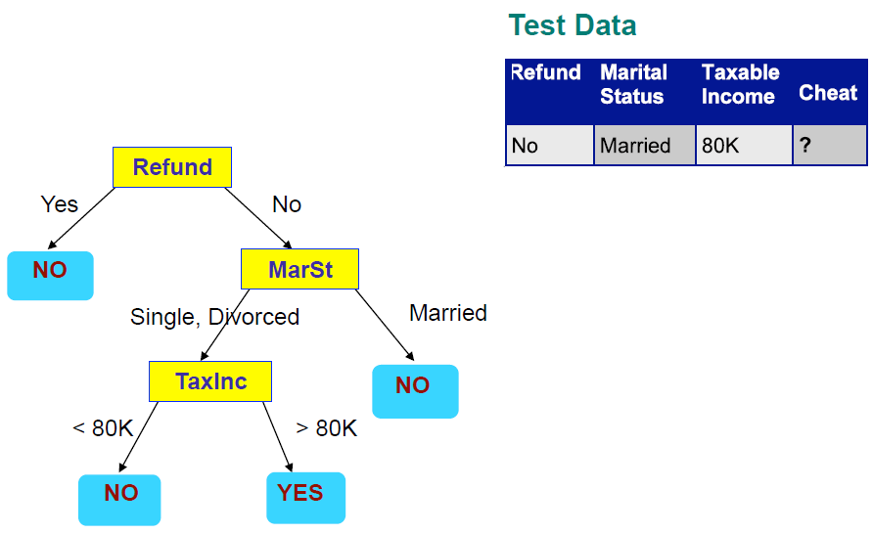
Applying a Tree to Test Data
Start from the Root Node

Slide 6
Decision Tree Structures
Decision trees are not unique in a training dataset – there are multiple tree structures that can be learned
Example: the Breast Cancer data
Input features include Clump Thickness, Uniformity of Cell Size, Uniformity of Cell Shape, Marginal Adhesion, Single Epithelial Cell Size, Bare Nuclei, Bland Chromatin, Normal Nucleoli, Mitoses
Target: binary target, whether the clump is malignant (1) or benign (0)
We can build different decision trees on this data to predict if a clump is malignant (1) or benign(0)
Examples on next slide

Slide 7
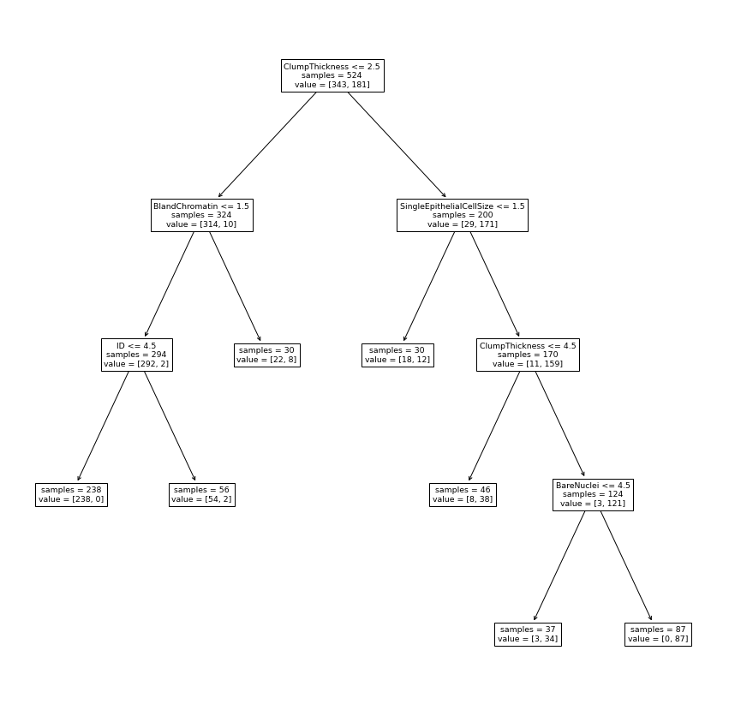
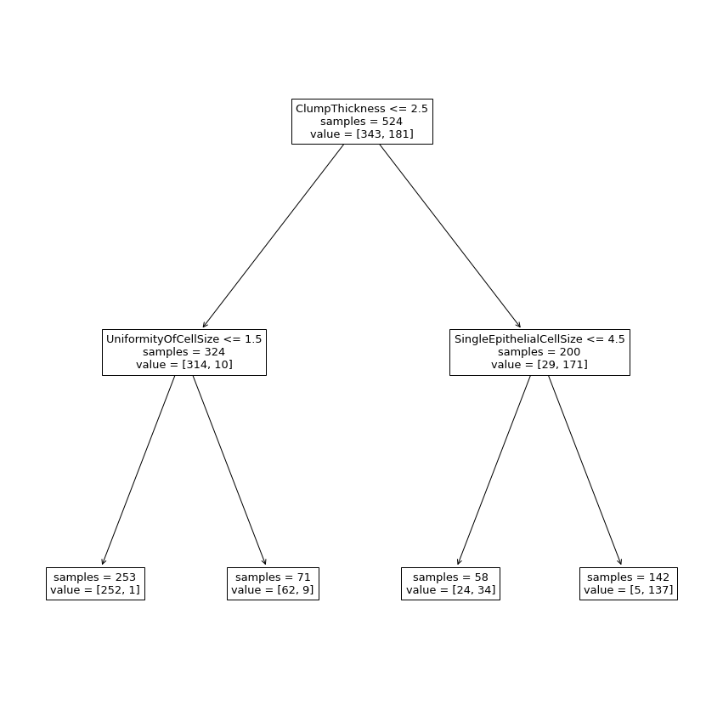
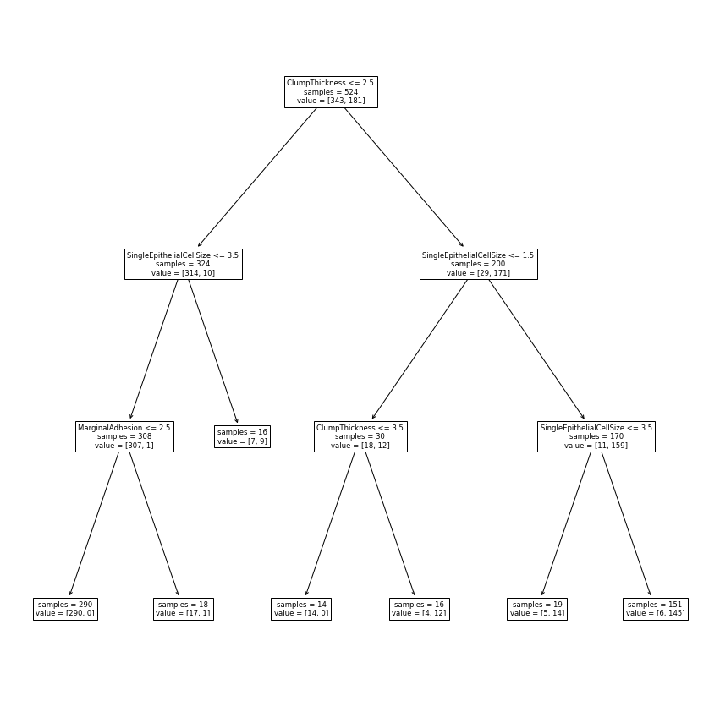
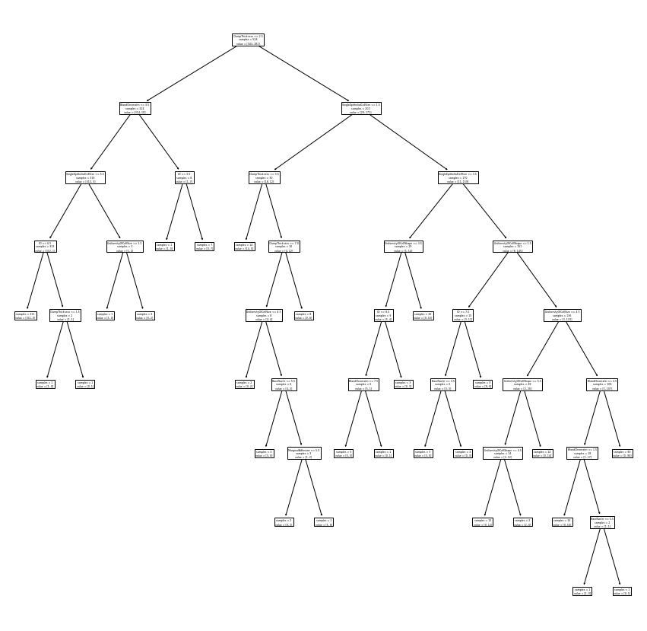
Different Decision Trees on the Data
Which tree to use?
How to choose a best tree for this data?

Slide 8

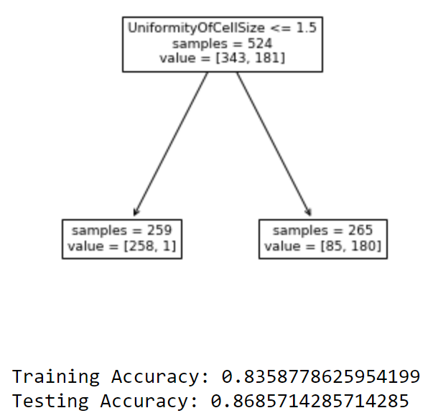
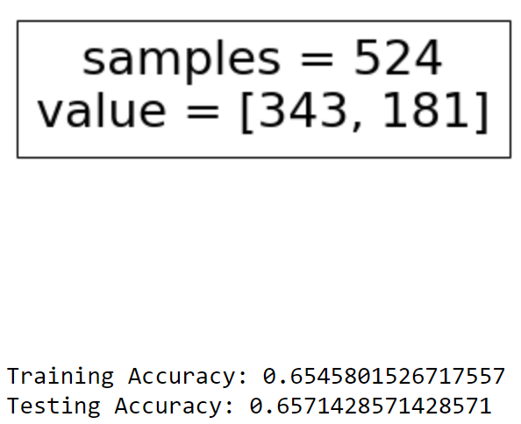
Hyperparameters
Root node
Are “metadata” of a model
For example: decision tree
Max depth: maximum depth (number of branches from the root node to the furthest leaf node) a tree can form
Minimum samples at split: minimum number of instances at a node for it to be eligible to form a split (have branches)
Cannot be learned from data
Heavily effect a model’s performance. Wrong selection of hyperparameters may lead to unusable models
Depth = 4
Furthest Leaf
Wrong selections of hyperparameters lead to an oversimplified tree with poorer performance

Slide 9
Model Tuning
The overall idea is to train the same model with different values of hyperparameters and pick one with the best performance
Due to the overfitting problem, tuning models using training performances is not ideal
Training performances are not enough to indicate if a model is overfitting or not
Testing data still represents totally new data for final evaluations and should not be used before a model is finalized
Further split training data into validation data for tuning models’ hyperparameters
All Data
Train/Test Split
Training Data | Testing Data
For final evaluations of models
Train/Validation Split
Training Data | Validation Data
For training models
For tuning models

Slide 10
Model Tuning with Validation Data
All Data
Train/Test Split
In general, the process is to train the same models with different hyperparameters with training data
Trained models are then scored in validation data
The model with the highest validation score is considered the best model and evaluated with testing data
Training Data | Testing Data
Train/Validation Split
Model Tuning
Training Data | Validation Data
Model training
Score 1
Model 1
Score 2
Final Evaluation
Model 2
…
…

Slide 11


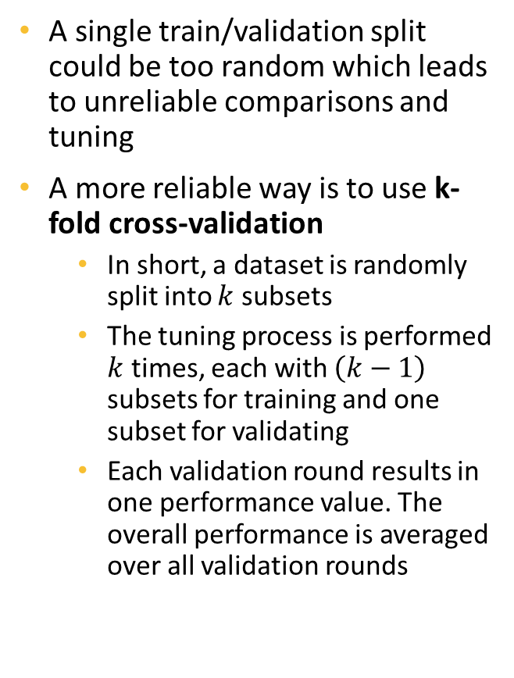



K-Fold Cross-Validation
Model training and validation
subset 2
subset 3
subset 4
subset 1
$$Accuracy_{1}$$
A single train/validation split could be too random which leads to unreliable comparisons and tuning
A more reliable way is to use k-fold cross-validation
In short, a dataset is randomly split into $k$ subsets
The tuning process is performed $k$ times, each with $\left(k−1\right)$ subsets for training and one subset for validating
Each validation round results in one performance value. The overall performance is averaged over all validation rounds
subset 1
subset 3
subset 4
Averaging
subset 2
$$Accuracy_{2}$$
All Data
subset 1
subset 2
subset 3
subset 4
$Accurac$y
subset 1
subset 2
subset 4
subset 3
$$Accuracy_{3}$$
Random split into 4 subsets
subset 1
subset 2
subset 3
subset 4
$$Accuracy_{4}$$
Training
Data
Validation
Data
Validation
Accuracy
4-Fold
Accuracy

Slide 12
Grid Search
Usually, a model has more than one hyperparameter that needs tuning. In a grid search, each hyperparameter is provided with a list of values
Each set of hyperparameter values then form a model to be tested and validated
The hyperparameter set that yields the highest validation score is considered the best one and is selected to apply on testing data
Max Depth | 2
Max Features | 5
Max Depth | 2
Max Features | 7
Max Depth | 2, 3
Max Features | 5, 7
Max Depth | 3
Max Features | 5
Hyperparameter
Grid
Max Depth | 3
Max Features | 7
Model to validate

Slide 13
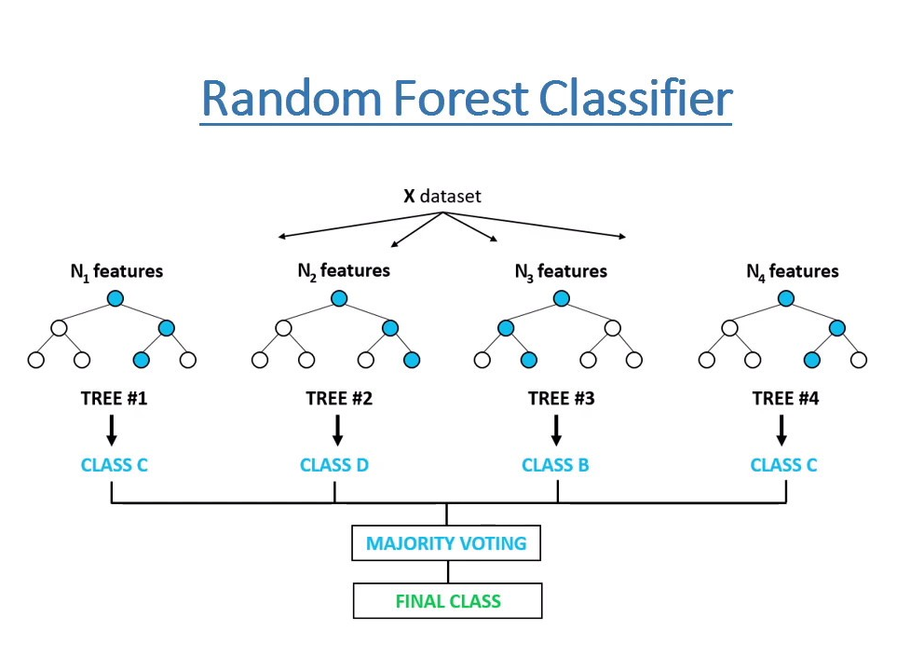
Random Forest
You may have guessed from the name; a Random Forest is an ensemble model that consists of multiple decision trees
Each tree is fit/trained using a random subset of the data (in terms of both instances and features)
When make predictions, each tree generates its own predicted values. The final decision is “voted” among the trees – the value with more tree predicted wins
The use of multiple trees
Stabilizes the model
Mitigates overfitting
Improve performances in general

